Slide 1
Signals and Communication Systems
AM and FM Transmitter and Receiver

Slide 2
AM Superheterodyne Receivers

Slide 3
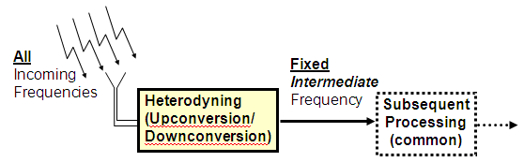
Heterodyning
Heterodyning is the generation of new frequencies by mixing two or more signals in a nonlinear device such as a vacuum tube, transistor, diode mixer.
Mixing of each two frequencies results in the creation of two new frequencies, one at the sum of the two frequencies mixed, and the other at their difference.
A low frequency produced in this manner is sometimes referred to as a beat frequency.

Slide 4
Superheterodyne Receiver
The basic selectivity problem in TRF systems led to the development and general usage of the superheterodyne receivers.
It was introduced in the early 1930s
This basic receiver configuration is still dominant after all these years, an indication of its utility
The superheterodyne receiver became popular because of its better selectivity, sensitivity and stability.

Slide 5
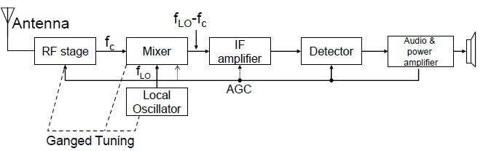
RF amplifier and Mixer
A standard RF amplifier. It is basically a tuned amplifier that picks up the desired station.
Mixer, which accepts two inputs and produce sum and difference frequencies. The RF tuned circuit and LO tuned circuit are ganged such that the difference frequency 455 kHz is produced.
Mixer is also known as First Detector

Slide 6
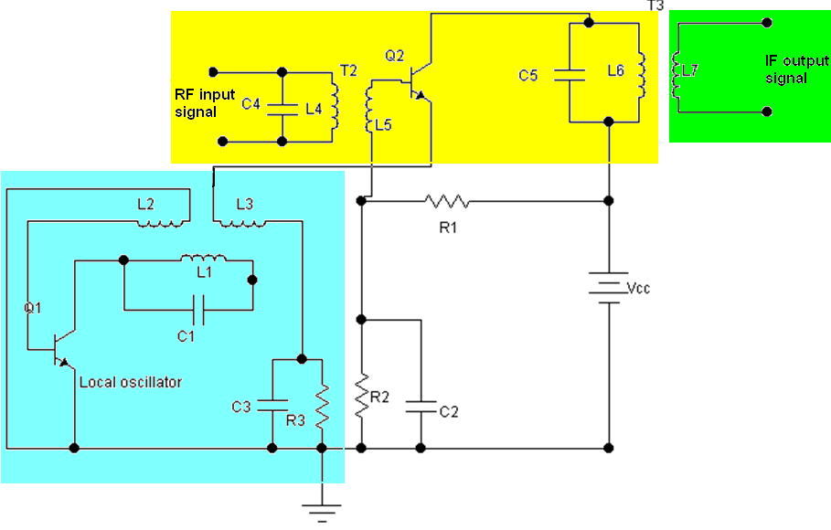
RF amplifier and Mixer

Slide 7
Session-32
Image frequency

Slide 8
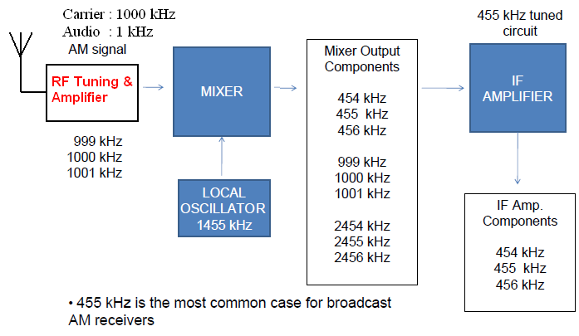
Example Frequency Conversion
Carrier + 455 kHz (IF)

Slide 9
Intermediate Frequency (IF):
Intermediate Frequency (IF): Selectivity is obtained.
Fixed frequency 455 kHz is produced irrespective of RF tuning.
Signal amplification at a fixed frequency This allows for a constant BW over the entire band of the receiver.
Since, the IF frequency is usually lower than the RF, voltage gain of the signal is more easily attained at the IF frequency

Slide 10
Detector and Audio amplifier
Following the IF amplifier stage is the detector, which extracts the intelligence from the radio signal
This signal is subsequently amplified by the audio amplifiers into the speaker

Slide 11
Automatic Gain Control (AGC)
This is the automatic gain control (AGC) which allows relatively constant receiver output for widely variable received signals.
A dc level proportional to the received signal’s strength is extracted from the detector stage and fed back to the IF amplifiers and sometimes to the mixer and/or the RF amplifier.

Slide 12
Image Frequency
An image frequency is any frequency other than the selected radio frequency carrier that, if allowed to enter a receiver and mix with the local oscillator, will produce a cross product frequency that is equal to the intermediate frequency.

Slide 13
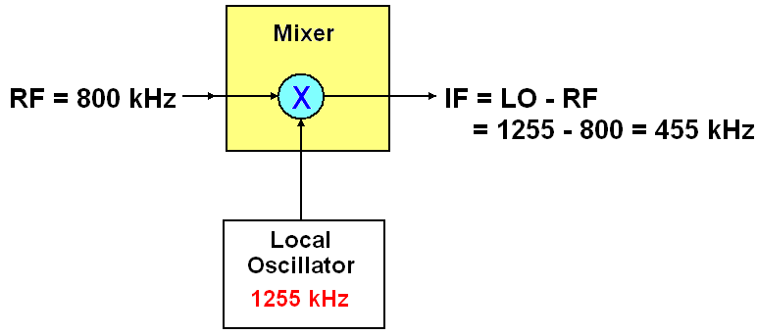


Example: Image Frequency

Slide 14
Image Frequency Rejection Ratio
The IFRR is a numerical measure of the ability of a preselector to reject the image frequency. For a single-tuned preselector, the ratio of its gain at the desired RF to the gain at the image frequency is the IFRR.
Mathematically, IFRR is
where, and
Q is a quality factor of tuned circuit

Slide 15
End

